Slide 1
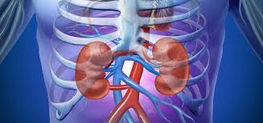
Perioperative acute kidney injury
Collective Review
R2 ต่อพงศ์ แม่นสำรวจการ
อ.สิทธาพันธ์ มั่นชูพงศ์

Slide 2
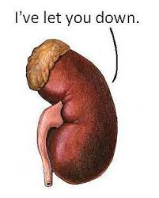
Outline
Background
Definition & Diagnosis
Incidence & Epidemiology
Pathophysiology
Risk factor
Prevention

Slide 3
Background
Acute kidney injury (AKI) is a rapid deterioration (hours to days) of renal function
Leads to accumulation of plasma waste products
Significant risk factor for chronic kidney disease
Induce distant organ damage
Can result in a prolonged hospital stay and a high mortality and morbidity

Slide 4
Background
Perioperative acute kidney injury (AKI)
A common morbid complication in surgical patients
Significant increases in mortality
Increased risk for chronic kidney disease (CKD) and hemodialysis after discharge
Increased cost and resource utilization
Mortality is higher in patients with perioperative AKI even after complete renal recovery
C. Hobson, et al.Cost and mortality associated with postoperative acute kidney injury
Ann Surg, 261 (6) (2015), pp. 1207-1214

Slide 5
Background
A recent large-scale cohort study with no history of CKD undergoing major surgery observed a 30-day mortality
1.9% in non-AKI compared with 31% in patients with AKI.
AKI does not always progress to renal failure requiring renal replacement therapy (RRT)
Variations in the Risk of Acute Kidney Injury Across Intraabdominal Surgery Procedures, Anesthesia & Analgesia. 119(5):1121–1132, NOV 2014

Slide 6
Background
short- and long-term complications
Infections and bleeding
Chronic kidney disease (CKD)
ESRD
Cardiovascular diseases
Death
The chronic disorders after an episode of AKI has major socioeconomic and public health effects

Slide 7
Definition & Diagnosis
In the past to describe kidney dysfunction arising from acute conditions
Acute renal failure
Acute kidney disease
Acute kidney syndrome
A review on the different classification systems found more than 35 definitions of acute renal failure

Slide 8
Definition & Diagnosis
In 2004 the RIFLE criteria
Replaced the term “Acute renal failure” to “Acute kidney injury”
Indicate the reversibility of the acute condition
Based on changes in serum creatinine from baseline or urine output

Slide 9
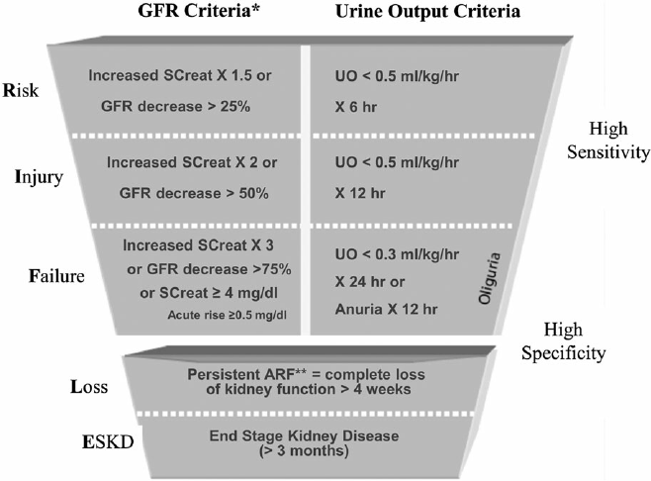
Definition & Diagnosis
RIFLE 2004
Three severity classes
Risk
Injury
Failure
Two outcome classes
Loss
End-Stage Renal Disease (ESRD)

Slide 10
Definition & Diagnosis
In 2007, the AKIN criteria
A modification of the RIFLE criteria
Attempt to improve their sensitivity
New staging system maps to the RIFLE stages as follows

Slide 11
Definition & Diagnosis
The AKIN criteria 2007

Slide 12
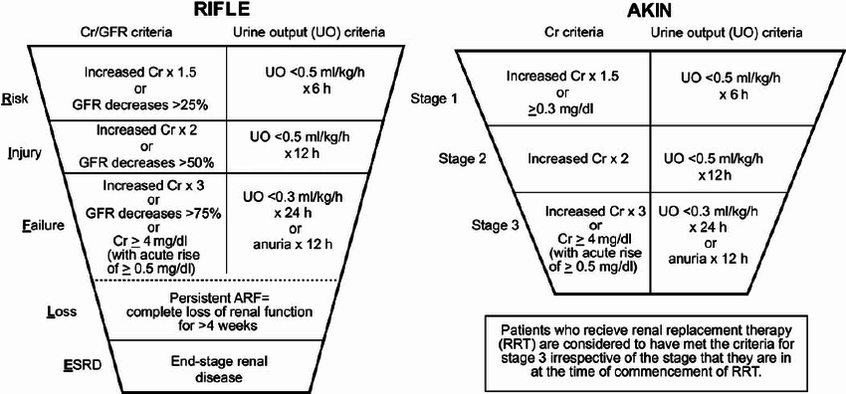
Definition & Diagnosis
RIFLE Vs AKIN

Slide 13
Definition & Diagnosis
In 2012, the Acute Kidney Injury Working Group of KDIGO released the latest classification system
Aim for unifying the RIFLE and AKIN criteria

Slide 14
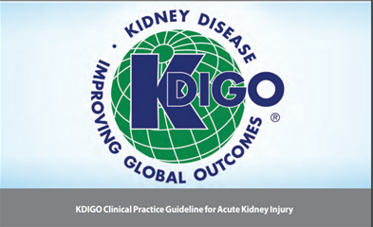
Definition & Diagnosis

Slide 15
Incidence & Epidemiology
Focuses on data published after RIFLE criteria in 2004.
In US, overall incidence of AKI
Approximately 600,000 AKI patients per year
10% to 20% progress to late-stage CKD
Up to 120,000 cases of CKD in at risk ESRD
AKI in hospitalized patients increased
From 4.9% in 1983 to 22.7 % in 2012

Slide 16
Incidence & Epidemiology
In critically ill patient
Incidence of AKI is between 22 and 57% in critical care patients
The Acute Kidney Injury–Epidemiologic Prospective Investigation (AKI-EPI) study
AKI occurred in more than half of ICU patients(57.3 %)
RRT was used in 13.5 % of ICU patients
97 ICU
1,802 patients
33 countries
Hoste E.Intensive Care Med 2015(Aug);41(8):1411-23

Slide 17
Incidence & Epidemiology
Perioperative AKI
Surgery remains a leading cause of AKI in hospitalized patients
The incidence ranges from 18%-47% of in hospital AKI
AKI is most common among cardiac surgery patients
15% of patients exposed to CPB will develop AKI
With 2% requiring RRT
Carmichael P, Carmichael AR: Acute renal failure in the surgical setting. ANZ J Surg. 2003, 73: 144-153.

Slide 18
Incidence & Epidemiology
In noncardiac surgery
AKI occurred in approximately 1% in normal kidney function patients
Non-cardiac surgery procedures pose a particular high risk
Patients with AKI during the course of surgery demonstrate an 8-fold increased risk for the progression to CKD
Gastric bypass surgery for morbid obesity
Liver transplant
Patients with preexisting CKD

Slide 19
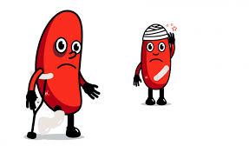
Pathophysiology
The development of perioperative AKI is precipitated by a variety of insults.
Hypoperfusion and inflammation are the major mechanisms

Slide 20
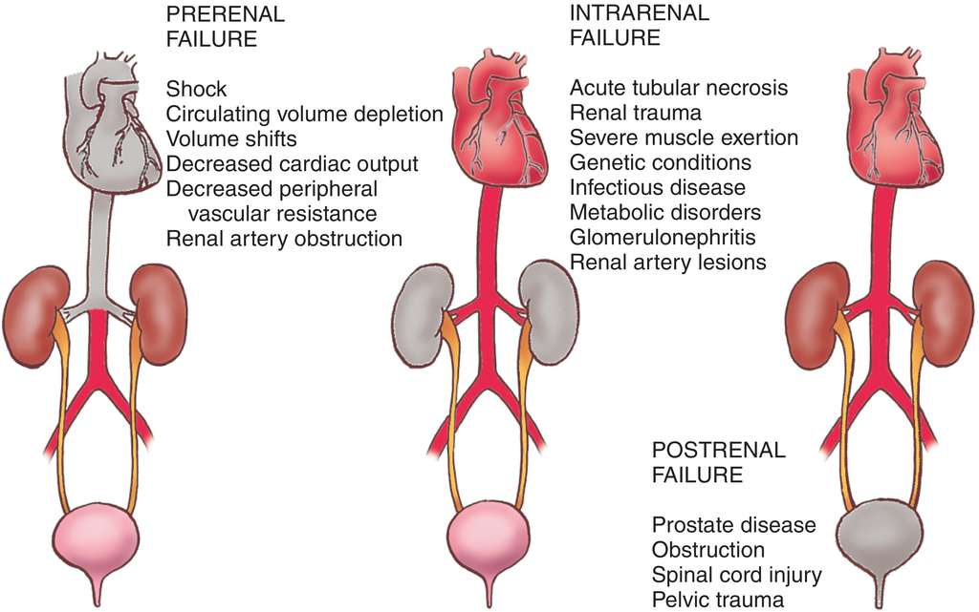
Pathophysiology
Most common trigger for AKI in the inpatient population
Sepsis
Major surgery
Acute decompensated heart failure
Bellomo R Kellum JA Ronco C. Acute kidney injury. Lancet 2012; 380: 756–66
Notes:
Prerenal35%,renal50%,post 10%
ในภาวะปกติไตได้รับเลือดประมาณ25%ของcardiac output
ปริมาตารสารน้ำที่ถูกกรองออกมาจากglomeruliขึ้นอยู่กับ glomerular capillary pressure ซึ่งถูกควบคุมโดยกลไก renal autoregulation
mean renal arterial pressure (MAP-intraabdominal pressure)ต่ำกว่า70mmHg เริ่มจะทำให้ renal autoregulationเสียไป
และGFRลดลง
พบว่าที่MAPต่ำกว่า50mmHgจะไม่มีการสร้างปัสสาวะออกมา
สาเหตุของ AKI แต่เดิม แบ่งได้เป็น pre-renal , renal, post-renal
pre-renal เกิดจากการลดลงของ renal perfusion
Renal เกิดจากการบาดเจ็บของเนื้อไตโดยตรง
post-renal เกิดจากการอุตันของทางเดินปัสสาวะ

Slide 21
Pathophysiology

Slide 22
Pathophysiology
The kidney is able to maintain GFR even in the face of changing arterial pressure and volume status
Reduced MAP &Renal perfusion
activated sympathetic system, RAAS
⬆ angiotensin II activity, antidiuretic hormone
Renal autoregulation
water retention, ⬆sodium absorption, and the preservation of GFR.

Slide 23
Pathophysiology
If hypoperfusion is not corrected, angiotensin II eventually causes vasoconstrict of both the afferent and the efferent arterioles, leading to reduces GFR.
The autoregulatory threshold

Slide 24
Pathophysiology
The simple ischemia model alone cannot explain sepsis and major surgery associated AKI.
Hemodynamics in sepsis are dominated by a hyperdynamic state, and global renal blood flow may remain intact.
Evidence suggests that systemic inflammation leading to tubular injury is responsible for sepsis-associated AKI.

Slide 25
Pathophysiology
Systemic inflammation
A uniform response of the organism to the trauma of surgery
Leads to tubular injury causing AKI
Tubular damage is caused by microcirculatory dysfunction, leukocyte migration, and endothelial dysfunction

Slide 26
Risk factor
Preoperative Risk Factors.
Patients with significant co-morbidities
Strongly associated with the development of AKI.
Chronic kidney disease
Metabolic syndrome(BMI >40)
Diabetes mellitus
Cardiovascular disease
Hepatobilliary disease
The most important is the preoperative level of kidney function
In cardiac surgery, rates of AKI requiring RRT approach 30% in patients with preexisting CKD
Thakar CV, Arrigain S. A clinical score to predict acute renal failure after cardiac surgery. J Am Soc Nephrol. 2005;16:162–168

Slide 27
Risk factor
Other reported risk factors in surgical patients are
Male sex
Functional dependence
Ventilator dependence,
COPD, smoking, bleeding disorders
Chronic steroid use
Cancer

Slide 28
Risk factor
Intraoperative Risk Factors : Surgery
Emergency surgery, major vascular surgery, and cardiac surgery is a high risk factor for AKI.
Intraperitoneal surgery, exploratory laparotomy and small bowl resections are more prone to develop AKI

Slide 29
Risk factor
Notes:
จากการศึกษาobservational study ที่ตีพิมพ์ในanesthesiologyในปี 2009
เก็บข้อมูลคนไข้ในโรงพยาบาลศูนย์ในประเทศสหรัฐอเมริกา 121 แห่ง ผู้ป่วยที่เข้ารวมการศึกษารวม75,952 คน
primary outcome ค้นหาปัจจัยเสี่ยงที่ทำให้เกิดperioperative AKI ในgeneral surgeryที่ไม่ใช่OPD case
การศึกษานี้ได้แยกผู้ป่วยที่ได้รับcardiac,vascular, obstetric, or urologic proceduresออก
และวิเคราะห์เปรียบเทียบ comorbidities และชนิดการผ่าตัดที่คนไข้ได้รับ ระหว่างกลุ่มคนไข้ที่เข้ารับการผ่าตัดแล้วเกิดAKIกับกลุ่มที่ไม่เกิดAKI
พบว่า9 ปัจจัยที่ต่างแตกกันอย่างมีนัยสำคัญทางสถิติในกลุ่มที่เกิดperioperative AKI ได้แก่

Slide 30
Risk factor
Risk factors | Harzard ratio
0-2 | 1
3 | 3.1
4 | 8.5
5 | 15.4
≥6 | 46.2
Notes:
1 intraperitoneal surgeryไม่รวมการผ่าตัดhernia
2 การทำงานของไตที่ผิดปกติตั้งแต่ก่อนการผ่าตัด
Mild preoperative renal insufficiency คือpreoperativeserum creatinine อยู่ในช่วง 1.2 ถึง1.9 mg/dl
moderate preoperative renal insufficiency คือpreoperative serum creatinine ≥2.0 mg/dl
3มีascites
4มีภาวะactive CHF
5 เข้ารับการผ่าตัดแบบemergency surgery
6 มีอายุ ตั้งแต่56ปีขึ้นไป
7 เป็นโรคเบาหวาน
8 เป็นโรคความดันโลหิตสูง
และ 9 เพศชาย

Slide 31
Prevention
Avoidance of nephrotoxic agents
Maintenance of volume status and perfusion pressure
Pharmacological interventions
Maintenance of normoglycemia
Novel biomarker
Renal Replacement Therapy

Slide 32
Avoidance of nephrotoxic agents
ACEIs and ARBs interfere with auto-regulation of renal blood flow and GFR.
NSAIDs causes acute inhibition of cyclooxygenase and can reduce GFR
Antibiotics : Cephalosporins, Aminoglycosides and Vancomycin commonly associated with acute interstitial nephritis include

Slide 33
A large population-based cohort study
A triple therapy combination of diuretics, ACEI or ARB and NSAIDs was increased risk of AKI
BMJ 2013; 346 (Published 08 January 2013)

Slide 34
Avoidance of nephrotoxic agents
Avoiding perioperative NSAIDs
Hypovolemic, hypotensive, elderly and diabetic patients, those with CKD and ACEI/ARB used
Ichai et al. Ann. Intensive Care (2016) 6:48, Acute kidney injury in the perioperative
period and in intensive care units

Slide 35
Avoidance of nephrotoxic agents
Minimising radiocontrast-induced kidney injury.
Prehydrate, using hypo- or iso-osmotic contrast , preemptive N-acetylcysteine
Surgery should be postponed in stable patients with contrast-induced AKI

Slide 36
Maintenance of volume status and perfusion pressure
Renal blood flow depends on both cardiac output and systemic arterial pressure.
Prolonged episodes of hypotension decrease renal perfusion and result in AKI
A MAP in the range of 65–75 mm Hg was accompanied by improved oxygen saturation and GFR and prevented AKI

Slide 37
Prospective, single-center, nonrandomized, open-label trial in the surgical intensive care unit
Norepinephrine was titrated in 11 patients in septic shock to achieve a MAP at successively 65, 75, and 85 mmHg
Result
MAP at 65 and 85 mmHg renal outcome are not difference
Increase MAP 65 to 75 mmHg ; improve urine output & renal resistive index
Deruddre, S., Cheisson, G., Mazoit, JX. et al. Intensive Care Med (2007) 33: 1557

Slide 38
Maintenance of volume status and perfusion pressure
A large retrospective cohort study of 5127 patients undergoing noncardiac surgery
observed associated with AKI when
MAP <60 mm Hg for more than 20 minutes and
MAP <55 mm Hg for more than 10 minutes
adjusted OR 2.34
Anesthesiology 9 2015, Vol.123, 515-523

Slide 39
Maintenance of volume status and perfusion pressure
Initial approach should be to reverse hypovolemia.
Inotropic therapy for management of low cardiac output.
Norepinephrine is an excellent first-line vasopressor agent.

Slide 40
Maintenance of volume status and perfusion pressure
Ichai et al. Ann. Intensive Care (2016) 6:48, Acute kidney injury in the perioperative
period and in intensive care units

Slide 41
Choice of fluid solution
Crystalloid solutions
Normal saline
Balanced solutions
Colloid solutions
hydroxyethyl starches (HES)
Gelatins
Albumin

Slide 42
Choice of fluid solution
Use of 0.9% saline is associated with development of hyperchloremia.
Saline infusion is correlated with reduced renal blood flow compared with balanced solutions.
RCT study on the effects of 2-L infusions of 0.9% saline and Plasma-Lyte® 148 on renal blood flow velocity and renal cortical tissue perfusion in healthy volunteers. Ann Surg 2012; 256: 18–24

Slide 43
Choice of fluid solution
In a large study in the ICU, chloride-restricted fluid management was associated with less AKI and renal replacement therapy.
Another large retrospective study found postoperative hyperchloraemia to be correlated with postoperative AKI

Slide 44
Choice of fluid solution
Association of colloid solutions with AKI is controversial
Hydroxyethyl starches (HES)
Several studies and meta-analyses found HES to be a risk factor for AKI

Slide 45
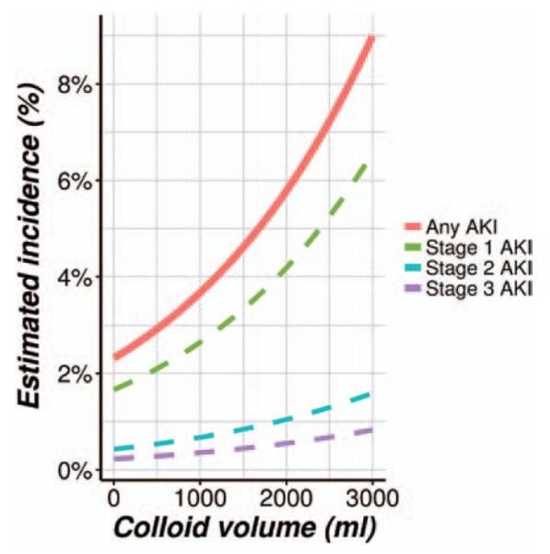
Choice of fluid solution
Dose-dependent renal toxicity associated with HES in patients having noncardiac surgery is consistent with randomized trials in critical care patients.
Anesthesiology 2014;121(4):730-739

Slide 46
Choice of fluid solution
Conclude
balanced crystalloids, blood products and albumin are probably safe.
Synthetic colloids can potentially cause kidney injury if used in large volumes or in septic patients.
High chloride loads and supra-physiological doses of bicarbonate should also be avoided.

Slide 47
Pharmacological interventions
Dopamine
Fenoldopam
Diuretics (furosemide/mannitol)
Natriuretic peptides - ANP, BNP

Slide 48
Pharmacological interventions
Dopamine
Dopaminergic receptor-mediated renal vasodilatation.
Beta-adrenoreceptor stimulation increases cardiac output.
Alpha-adrenoreceptor increases renal perfusion pressure.
In the perioperative setting, dopamine increases post-operative urine output but does not improve outcome.
Systematic reviews have concluded that there is no role for low-dose dopamine for clinically significant renal protection

Slide 49
Pharmacological interventions
Fenoldopam
Increases renal blood flow by its selective action on dopamine-1 receptors.
At present, there is conflicting evidence.
Several studies found no benefits as a renal protector.
Morelli et al. found a slight increase on creatinine clearance using low-dose fenoldopam in septic patients.

Slide 50
Pharmacological interventions
Diuretics (furosemide/mannitol)
Diuretics may improve urine output in the setting of acute kidney injury
There is no evidence to support that they confer any improvement in outcomes measured
Notes:
เชื่อว่าmannitolมีpotentially renal protective effectsด้วยกลไกเพิ่มGFRทำให้ removal tubular casts, dilution nephrotoxic substances และ ลดการบวมของ tubular epithelium แต่จากการศึกษาSystematic review ไม่พบว่าmannitolลดอัตราเกิดAKI ยิ่งไปกว่านั้นการให้mannitolในคนไข้ inadequate volume status ทำให้ intravasular volumeยิ่งลดลง ยิ่งเพิ่มความเสี่ยงให้เกิดAKIมากขึ้น

Slide 51
Pharmacological interventions
Diuretics (furosemide/mannitol)
Ichai et al. Ann. Intensive Care (2016) 6:48, Acute kidney injury in the perioperative
period and in intensive care units

Slide 52
Pharmacological interventions
Natriuretic peptides - ANP, BNP
Synthetic analogue of a brain natriuretic peptide.
Secreted due to ventricular distention.
Nesiritide promotes renal vasodilation, increasing renal blood flow.

Slide 53
Pharmacological interventions
Natriuretic peptides - ANP, BNP
Large multi-centre trials have demonstrated that
atrial natriuretic peptide (ANP) does not prevent death or dialysis in critically ill patients with ARF
Small single centre trial,
recombinant human ANP has been shown to reduce the need for dialysis in post-operative cardiac surgical patients with early acute renal dysfunction.

Slide 54
Maintenance of normoglycemia
Tight glycemic control has been shown to significantly reduce AKI in critically ill patients
Intensive insulin therapy blood glucose 80-110 mg/dL Vs 180-200mg/dL
Reduce ARF require RRT 41%
N Engl J Med. 2001 Nov 8;345(19):1359-67

Slide 55
Maintenance of normoglycemia
Peri-operative hyperglycemia during cardiac and vascular surgery is associated with increased renal morbidity and overall mortality
Development of strategies that focus on avoiding large variations in blood glucose and hypoglycemia

Slide 56
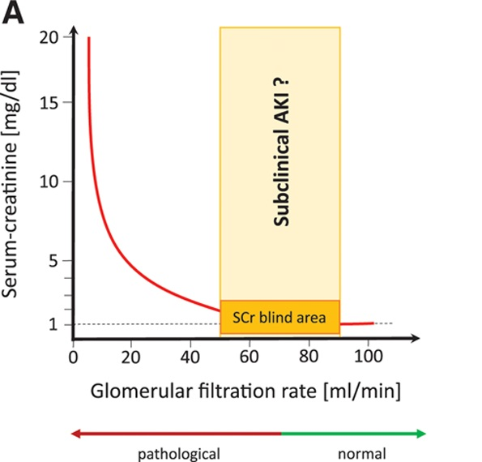
Novel biomarker
SCr and urine output are functional biomarkers changing late during the development of AKI.
Current research aim to identify new biomarkers
released before sCr increases and/or urinary output declines

Slide 57
Novel biomarker
Neutrophil-gelatinase–associated lipocalin (NGAL),
Tissue inhibitor of metalloproteinases-2 (TIMP-2),
Insulin-like growth factor binding protein 7 (IGFBP7)

Slide 58
Novel biomarker
After ischemic or nephrotoxic insults, a significant increase in plasma and urine occurs, prompting the notion that NGAL is the “troponin” of the kidneys
Multi-trauma adult (N=31)
Cut-off point >25 ng/mL :
sensitivity of 91%
specificity of 95%
Makris K.Clin Chem Lab Med 2009;47:79-82
Notes:
ในปัจจุบันมีความพยายามศึกษา biomarkerหลากๆชนิดเพื่อนำมาใช้ประโยนช์ในการวินิจฉัยภาวะAKI
โดยbiomarkerควรมีคุณสมบัติสามข้อหลักคือ
1 สามารถนำมาใช้วินิฉัยโรคได้รวดเร็วถูกต้อง
2 บอกความรุนแรงและprognosisของโรค
3 ใช้ติดตามผลการรักษาหรือการดำเนินไปของโรค
ยกตัวอย่าง 3 biomarkerที่กำลังได้รับความสนใจ
ตัวแรก Neutrophil gelatinase-associated lipocalin หรือต่อไปขอเรียกว่า NGAL
NGAL เป็นantimicrobial protein สร้างขึ้นมาโดยcellที่มีนิเคลียสในร่างกายหลักๆเป็นneutrophil
และ NGALยังพบได้ในdistal tubule และ collecting duct
พบว่าปริมาณ NGAL ถูกสร้างมากขึ้นเมื่อมีการการเจ็บของtubular cell เชื่อว่าเกิดจากกลไกinflammation
เชื่อว่า NGAL แยกภาวะprerenal azotemia คือภาวะที่ไตทำงานลดลง แต่tubular functionยังไม่เสียการทำงาน กับภาวะAcute Tubular Necrosis ต่อไปขออนุญาตย่อว่า ATN คือภาวะที่ tubular cell เสีการทำงานไป
ปัจจุบันมีการศึกษาทางคลินิกเพื่อนำNGAL มาใช้วินิจฉัยภาวะAKIภายใน1-2ชั่วโมงหลังไตได้รับบาดเจ็บ
พบว่าการตรวจurine NGAL มีspecificity กับภาวะAKI มากกว่าserum NGAL แต่อย่างไรก็ตามในคนไข้ที่ไม่มีปัสสาวะก็สารถใช้ค่าserum NGALได้
จากการศึกษาที่ตีพิมพ์ในclinical chemistry and laboratory medicine ศึกษาระดับurine NGALในคนไข้multiple traumaจำนวน31คน
พบว่า cut-off point : urine NGALในวันแรกถ้ามากกว่า >25ng/mL มีsensitivity และspecificityสูงมากในการวินิจฉัยAKI
ข้อจำกัดหลักในการนำurine NGAL มาใช้คือ cut-off point วิธีการตรวจตลอดจนtimmingที่เหมาะที่

Slide 59
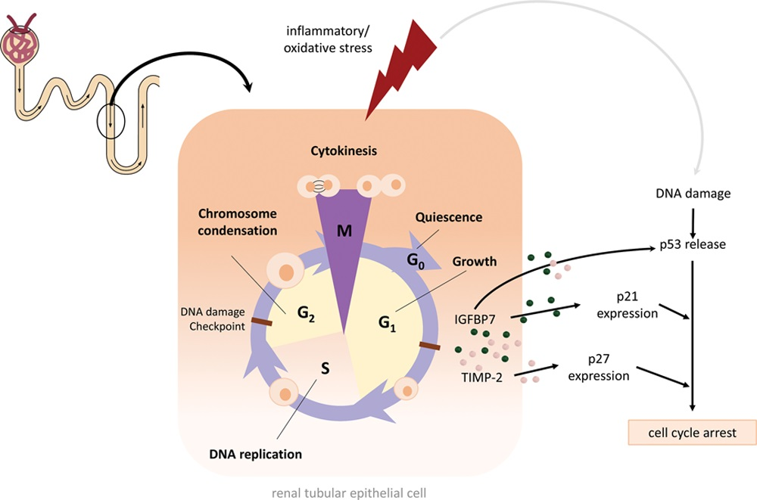
Novel biomarker
Tissue inhibitor of metalloproteinases-2 (TIMP-2) & Insulin-like growth factor binding protein 7 (IGFBP7)
Inflammatory or oxidative stress results in DNA damage of renal tubular epithelial cells.
This leads to a release of TIMP-2 and IGFBP

Slide 60
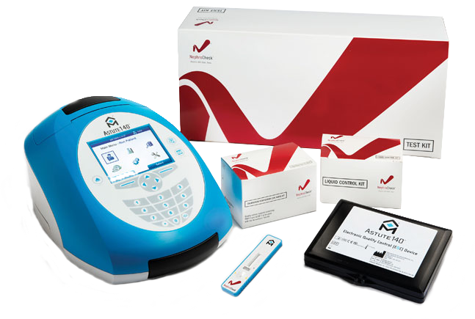
Am J Kidney Dis. 2016 Jul; 68(1): 19–28.

Slide 61
Remote Ischemic Preconditioning
Notes:
ปัจจุบันมีการพูดถึง Remote ischemic preconditioning กับมากขึ้น
เชื่อว่ามีกลไกneurohormonal pathwayบางอย่างในร่างกายทำให้อวัยวะต่างทำงานสัมพันธ์กัน ที่รู้จักกันในกลไกorgan cross talk
Remote ischemic preconditioning มีการรัดแขนข้างหนึ่งพบกว่าเลือดไปเลี้ยงร่างกายส่วนต่างดีขึ้นโดยมากเป็นการศึกษาในคนไข้acute coronary diseaseที่เข้ารับการทำPercutaneous Coronary Intervention

Slide 62
Systematic review (N=8,168) : 37 RCTs from 2007 to 2015
Result : RIPC
Reducing AKI in patients following PCI (RR 0.64, 95% CI 0.46-0.87)
But not after cardiac surgery (RR 0.93, 95% CI 0.82-1.06)
No difference for changes in the incidence of RRT, GFR or sCr
Journal of Critical Care Volume 33, June 2016, Pages 224-232
Notes:
การศึกษาSystematic review เกี่ยวกับ Remote ischemic preconditioning ตีพิมพ์ในcritical carเดือนมิถุนายนที่ผ่านมารวบรวม37 randomized control trial ตั้งแต่ปี 2550ถึงปี2558พบว่า การทำRemote ischemic preconditioning ลดภาวะAKIในคนไข้ที่มาทำPCI
ยังคงต้องการการศึกษาการนำRemote ischemic preconditioning มาใช้ป้องกัน perioperative AKI

Slide 63
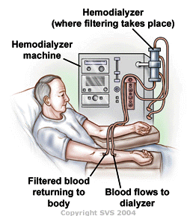
Renal Replacement Therapy
The KDIGO guidelines recommend initiation of RRT when life-threatening fluid accumulation or significant imbalances
“early” or “late” initiation of RRT
Possibility that at that time AKI is already irreversible
Risks and complications of an invasive therapeutic procedure

Slide 64
Compared a strategy of initiation of RRT
KDIGO stage 2 versus KDIGO stage 3
Result : Early RRT
Reduce 90 day mortality
Recovered renal function
Reduce length of hospital stay
JAMA. 2016 May 24-31;315(20):2190-9.

Slide 65
CONCLUSIONS : Perioperative AKI
Diagnosis & Definition : KDIGO 2012
Risk of AKI :
Preoperative = patient comorbidity (CKD,CVS,DM)
Intra/post operative = Type of surgery, Intraoperative hypotension
Goal of treatment is prevention
Avoid nephrotoxic
Maintain RBF & avoid hypo/hyperglycemia
Restrict Chloride rich solution & HES
Early detection & appropriate RRT

Slide 66
Read more !!
Perioperative acute kidney injury BJA: Volume 115, Issue suppl_2, 1 Decmber 2015,
Perioperative Acute Kidney Injury: An Under-Recognized Problem Anes&Anal: October 2017
Perioperative acute kidney injury, Perioperative Medicine2012
Perioperative Acute Kidney Injury: Risk Factors and Predictive Strategies, Critical Care Clinics Volume 33, Issue 2, April 2017
Acute kidney injury in the perioperative period and in intensive care units, Ann. Intensive Care (2016)
KDIGO Clinical Practice Guideline for Acute Kidney Injury

Slide 67
THANK YOU

